Slide 1
IARC Benefit Plans
World Vegetable Center
14 June 2018

Slide 2
Today’s Topics
About AIARC
Retirement Plan
Basics of Investing
International Plan
U.S. Plan
Insurance
Medical & Evacuation
Death & Disability
How your Insurance Works - Sample Scenarios

Slide 3
www.AIARC.org
Brochures
Instructions
Forms
Contact information
Links to partner (vendor) information

Slide 4
About AIARC
AIARC performs the following centralized management functions on behalf of its member Centers:
Disburses $150 million annually for payroll, retirement plan contributions, and insurance premiums;
Acts as the administrator and fiduciary for more than $480 million in retirement fund assets divided between a U.S. 403 (b) plan and an offshore plan located in Guernsey;
Acts as the administrator and contracting agent for insurance coverage for over 6,700 employees and dependents to include: medical, emergency evacuation, life, long-term disability, accidental death and dismemberment, and business travel accident; and
Serves as the paymaster and administrator for payroll services for over 1,500 employees in 83 countries worldwide.
Notes:
The purpose of AIARC is simply to pool and leverage the Centers’ resources.
The more people or more money you have the better position you are to negotiate volume discounts.
We have 23 Centers. Handle over $170 million in payroll, insurance, and retirement payments; and we hold over $400 million in assets.
AIARC supports and leverages the Centers’ resources by providing centralized management of specialized payroll and benefit functions to reduce administrative time and costs. This pooling of resources provides the Centers with benefits and services that would not be available or economical if performed individually.

Slide 5
AIARC Board of Directors
Chair | Dr. Barbara Wells | Director General, CIP
Affiliated | Vacant | Finance Head
 | Vacant | Finance or HR Head
 | Sherian Abramaitys-Yi | Director of Human Resources, IFPRI
 | Kumar Tumuluru | Deputy Director General - Operations, CIFOR
Non-Affiliated | Nagaraj Inukonda | Director of Human Resources, World Vegetable Center
External | Judy Vukovich | External Director
AIARC | Jeffrey Hungate | President & CEO

Slide 6
AIARC Staff Resources
Jeffrey Hungate, President & CEO
Jasmine Goh, Director of Accounting
Yili Shao, Director of Information Systems
David Stinson, Director of Finance
Afifa Haque, Manager of Corporate Communications
Renae Liu, Manager of Payroll & Benefits
Madiha Babar, Payroll & Benefits Coordinator
Soumia Elidrissi, Payroll & Benefits Coordinator
Yoorim Shin, Payroll & Benefits Coordinator
Edith Stokes, Payroll & Benefits Coordinator
Su Naing, Payroll & Benefits Coordinator

Slide 7
IARC Retirement Plan
World Vegetable Center
14 June 2018

Slide 8
Retirement Plan Topics
Basic Concepts of Investing
Power of Compound Interest
Risk & Reward
International (Offshore) and U.S. Plans
Plan Structure
Eligibility / Contributions
Custodial Account / Oversight
Investment Fund Options
Platform Functions

Slide 9
Presentation Note
Please note that:
AIARC is not an investment advisor, and
if you need personal advice about investments, you should consult with a financial professional.

Slide 10
Basic Concepts of Investing

Slide 11
Key Questions
Why should I invest?
How much do I need to invest?
Why buy a bond?
Why buy a stock?
What are the best investments for me?
What are the risks?
How do you reduce risk?
Why buy mutual funds?

Slide 12
Why Should I Invest?
In general, an individual invests to create wealth for a home, a child’s education, or retirement.
The purpose of the IARC Retirement Plan is to provide a vehicle that allows you to accrue financial resources so you can leave your job at retirement and still live comfortably while not working.
Notes:
Wealth is simply the accumulation of financial resources
Millionaires – regular investing over an extended period of time.
Not DGs of Centers.

Slide 13
How is wealth created?
Wealth (the accumulation of financial resources) is created when:
Your money earns money
You buy something with your money that could increase in value

Slide 14
Your Money Earns Money
Someone pays you to use your money for a period of time. For example:
A bank will pay you interest on a savings account so it can loan your money to someone else at a higher rate
A corporation will pay you dividends on a share of stock so it can invest in its operations

Slide 15
Buy Low, Sell High
You buy something that you hope will increase in value over time. When you need your money back, you sell it hoping someone else will pay you more for it. For example:
Real estate
Gold
Stocks

Slide 16
How much do I need to invest?
Very little because small investments can add up to a big sum of money over time.
The Power of Compounding
You earn interest on the money you invest, and then you earn interest on the prior interest earned

Slide 17
“Compound interest is the most important invention in all of human history.”
–Albert Einstein

Slide 18
Power of Compounding
Notes:
The higher the rate, the higher return.
$40 per month over 10 years equal a total investment of $4,800.
$40 per month over 40 years equal a total investment of $19,200.

Slide 19
Power of Compounding
Notes:
For an additional $20 per month over 40 years (for a total investment of $9,600), you will gain an additional $65K at the 8% earnings rate.

Slide 20
Investment Asset Classes
In general, there are three primary asset classes:
Cash
Bonds
Stocks
Notes:
Cash no maturities/very liquid- bank checking and saving accounts

Slide 21
Bonds
A bond is a loan.
When you buy a bond, you become a lender to a corporation or government (borrowers).
Corporations and governments raise money from investors by issuing bonds for capital projects, financing debt, and cash flow.
Notes:
Governments issue bonds for roads, schools
Corporations issue bonds to build plants, buy equipment, etc.

Slide 22
Why buy a bond?
When you (the investor) buy a bond, you are lending to the issuer (the borrower) who promises to pay you a specified rate of interest during the life of the bond and to repay the principal when the bond matures.
In general, you buy a bond to:
Receive a predictable income stream
Preserve the principal investment
Notes:
When you buy a bond, you are making a loan and you expect to receive your money (principal) plus interest back by a specified date (time-frame) (P*R*T).
Predictable income - Most bonds provide a regular stream of interest payments on specified dates. As a result, bonds can be used to try to generate a predictable stream of income.
Preservation of principal – You get your amount invested back when the bond matures plus interest.

Slide 23
Stocks
A stock is a receipt of ownership.
Corporations issue stocks to investors so they can raise funds to:
Pay off debt
Launch new products
Expand into new markets
Enlarge facilities or build new ones
Notes:
Corporations sell a part of their company to investors to raise funds.
When you buy a shirt at a store you get a receipt that proves that you own the shirt.
When you buy a stock, you become a business owner.

Slide 24
Why buy a stock?
When an investor purchases a stock, he or she becomes a proportional owner of the company.
In general, you buy a stock for:
Capital appreciation (buy low, sell high)
Dividend payments (your money earns money)
Notes:
As an owner you share in the profits and losses of the company. 1 share out of 100 shares issued means you own 1% of the company
As a company’s earnings improve, stock investors hope to achieve increases in the dividends paid in the price of the stock.
Capital appreciation occurs when a stock price is greater than purchase price (Buy Low, Sell High)
Dividend Payments occur when a company shares its profits with the investors
The value of a stock is set by many people trading it in a free, open market—most often a stock exchange. The price of a stock fluctuates according to supply and demand based on people’s respective perceptions.

Slide 25
What are the best investments for me?
The answer depends on your personal Risk Tolerance and your investment Time Horizon
Risk Tolerance is your willingness to lose some or all of your original investment in exchange for potentially greater returns.
Time horizon is the number of months, years, or decades that you have to keep your savings invested.
Notes:
Investment selection depends on when you will need the money and if you will be able to sleep at night if you purchase an investment where you could lose your money.
Investors with a longer Time Horizon may feel more comfortable selecting riskier investments, i.e. younger people.

Slide 26
Risk and Reward
In finance, risk refers to the degree of uncertainty about the rate of return on an asset and the potential harm that could arise when financial returns are not what the investor expected.
In general, an investor requires a higher return to compensate for taking a higher risk.
Notes:
Risk and Reward go hand-in-hand. You can’t talk about one without talking about the other.
The risk is the uncertainty of not getting your money back. Risk is not getting what you expected.
You may charge your mother a lower rate for a loan than you would a stranger.
You might charge your mom a lower rate for a loan versus a friend
You don’t know if an asset price is going to go up or down or by how much

Slide 27
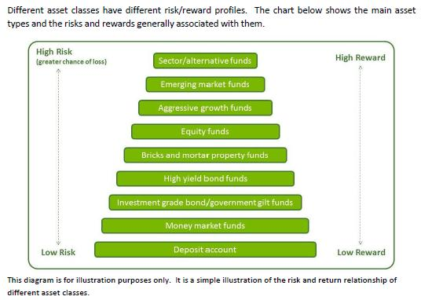
Risk & Reward
Notes:
Stocks are considered higher risk than bonds, and bonds are considered higher risk than money market accounts.

Slide 28
Risk & Reward
Stocks have the potential for the highest returns but also have the greatest risk. The volatility of stocks makes them a very risky investment in the short-term.
Bonds are generally less volatile than stocks and offer more modest returns, but bonds offer higher returns than money market funds.
Notes:
Bondholders are considered to have less risk than stockholders because they have predictable (contracted) returns and get first claim to the assets of company in bankruptcy.

Slide 29
Risk & Reward
Money market funds are a type of mutual fund that invests in high quality short-term (less than 90 days) debt. They pay dividends that reflect short-term interest rates.
Money market funds are considered the safest investments of the three asset classes, but offer the lowest returns. The principal concern to investors is inflation risk.
Notes:
Inflation risk is the price of goods increasing at a greater rate than money earned in a bank account.

Slide 30
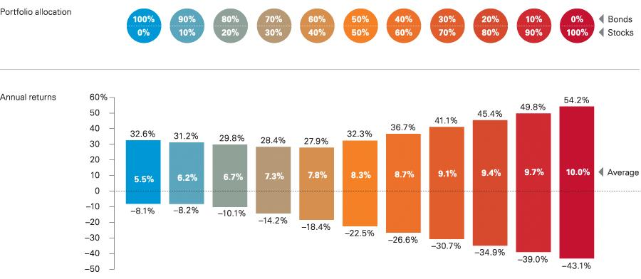
Historical Returns – Past 20 Years
Notes:
This chart demonstrates the volatility of bonds versus stocks and an average return over a 20 year time.
A 100% bond portfolio resulted in a single worst year being a negative (8.1%) and a single best year being 32.6% and the 20 year average being 5.5%
A 100% stock portfolio resulted in a single worst year being a negative (43.1%) and a single best year being 54.2% and the 20 year average being 10.0%
The chart shows that stocks are more risky in the short-term because their fluctuations in a single year are substantially greater than bonds, but their overall return tends to be greater in the long-term.

Slide 31
What are the risks?
Business Risk
Market (Volatility) Risk
Interest Rate Risk
Inflation (purchasing power) Risk
Notes:
Business Risk is the risk that a company will go bankrupt and can’t pay interest or dividends making the bonds and stocks worthless.
Volatility Risk is the fluctuation in a stock price which may be unnerving for investors causing them not to be able to sleep at night and the investor selling the stock at the wrong time.
Interest Risk is that a bond’s price changes due to the fluctuation in interest rates. Buy a bond at 5%, next day it goes to 8%. An inverse relationship exists between bond prices and interest rates.
Inflation Risk is the risk that the price of goods will increase at a greater rate than what can be earned on investments. Individuals lose purchasing power.

Slide 32
How do you reduce risk?
Diversify – “Don’t put all your eggs in one basket.”
Allocate your investments among different asset classes such as cash, bonds, and stocks.
Further allocate your investments within each asset class, i.e., stocks invest in large, small, and global company stocks .
Notes:
The idea is that if one investment loses money that the other investments will help offset the loss.
In the past bond returns have moved in the opposite direction of stock prices. When interest rates are low companies borrow money to increase capacity for producing goods causing stock prices to rise.
Geographical areas move in opposite directions U.S. versus Europe versus China.
Industries move in opposite directions.

Slide 33
Mutual Fund
A mutual fund is a company that pools money from many investors and invests the money in securities such as money markets, bonds, and stocks. Each share represents an investor’s part ownership in the fund
A share value will rise or fall as the values of the individual stocks and bonds within the fund rise and fall
Notes:
Mutual funds allow a group of investors to combine their cash and invest it. By pooling their money together, mutual fund investors can buy broader range of stocks or bonds than they could if they were trying to buy the stocks and bonds on their own.
When you make an investment in a fund, you purchase shares of the fund, which means you own a portion of all of the underlying investments.

Slide 34
Why buy mutual funds?
Affordability
Diversification
Liquidity
Dividend/Interest Payments
Appreciation in Share Price
Notes:
Diversification – Don’t put all of your eggs in one basket. Helps lower risk if one company fails.
Affordable – low price
Liquidity – Investors can easily redeem their shares.
Dividend Payments include both interest and dividends
Capital Gain Distributions- buy and selling of stock at a profit

Slide 35
Types of Mutual Funds
Money Market Funds
Bond Funds
Stock Funds
Balanced Funds
Lifecycle / Target Date Funds
Notes:
In general four types of mutual funds – money market, bonds, stocks, and lifecycle

Slide 36
Lifecycle / Target Date Funds
Hold a mix of cash, bonds, and stocks.
Designed to make investing for retirement more convenient by automatically changing your asset allocation over time.
The fund manager will make all decisions about the allocation of cash, bonds, and stocks for you based on your investment time horizon.
Notes:
Lifecycle Funds hold a mix of stocks and bonds, and automatically shifts its asset allocation at certain points in your life, based on age or time to retirement.

Slide 37
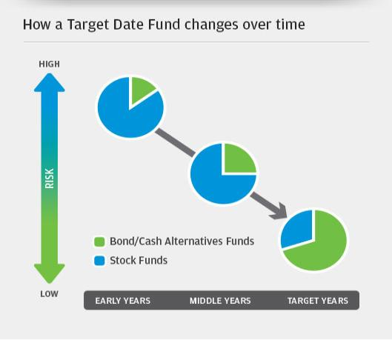
Your assets should change with changes in risk tolerance

Slide 38
Questions?

Slide 39
IARC International (Offshore) Retirement Plan

Slide 40
International Retirement Plan Topics
Plan Structure
Eligibility / Contributions
Custodial Account / Oversight
Investment Fund Options
LifeCycle Concept
Plan Platform - Allianz

Slide 41
International Retirement Plan Resources
AIARC.org Website
IARC Retirement Plan Participant Brochure
IARC Retirement Plan Investment Brochure
IARCPlan.org (Allianz Plan Platform)
LifeCycle Brochure & Video
Fund Factsheets
Retirement Calculators

Slide 42
Plan Structure
International (Offshore)
Retirement Plan

Slide 43
Key Questions
Who is eligible to participate?
What is a trust?
What is a custodial account?
Who oversees the trust?
How much does my employer contribute?
Can I make my own contributions?

Slide 44
International Retirement Plan Eligibility
To be eligible for the International (Offshore) Retirement Plan, you must be actively employed by a Center and be a non-U.S. Taxpayer.
Note: The tax treatment of any contributions into and any benefits taken from the Plan will depend on your own personal circumstance and country of residence.

Slide 45
International Retirement Plan Structure
The plan was established in 1996, under a trust in Guernsey, to help Centers’ employees save for retirement.
A trust is a separate legal arrangement that segregates the assets of the plan from those of the Centers and AIARC.
All assets of the trust are held in a custodial bank with Citibank.
Notes:
A trust is a legal relationship whereby property is held by one party, the trustee, for the benefit of another, the participants.
The trust’s assets are held in a custodial account. This framework makes your retirement savings not dependent on the continued operations of the Center or AIARC.

Slide 46
International Retirement Plan Structure
The operations of the trust are governed by Guernsey laws and are overseen by the IARC Plan Board of Directors.
Under a management agreement with the trust, AIARC administers the day-to-day activities of the trust.
AIARC contracts with Allianz to administer the International Plan’s platform.

Slide 47
Contribution Schedule
Center (Employer)
15% of gross month salary
Voluntary (Employee)
Up to 100% of your net salary on a monthly basis

Slide 48
Voluntary Contribution
To add or change a voluntary contribution, the employee must complete the Offshore Retirement Plan Voluntary Contribution Change Form –AllianzGI and submit to AIARC.
For investment choices, the new or changed contribution amount is allocated in the same percentage and to the same funds as the existing voluntary contribution.

Slide 49
Investment Fund Options
International (Offshore)
Retirement Plan

Slide 50
International Retirement Plan Investment Fund Options
8 fund managers with 24 fund choices
LifeCycle Concept (fund of funds)
Actively managed funds and passive (index) funds
Diverse mix of asset classes
To include geography and currency

Slide 51
International Retirement Plan Fund Managers
Aberdeen Asset Management | PIMCO Global Advisors
Allianz Global Investors | State Street Global Advisors
BlackRock Asset Management | Threadneedle Investment Services
Goldman Sachs Asset Management | The Vanguard Group
Notes:
BlackRock is the world's largest asset manager and State Street Global Advisors (SSgA) is the world’s second largest asset manager.
Aberdeen Asset Management the largest listed fund manager in Europe.
Vanguard is the words largest provider of index mutual funds
PIMCO runs the largest bond mutual fund in the world, the PIMCO Total Return Fund.
Allianz is the world's largest insurance (financial services) company.

Slide 52
Index (Passive) Fund
An index fund attempts to mimic the return of a specific market index, i.e., S&P 500, FTSE, TAIEX, etc. It contains all of the holdings of the index.
Fees are generally lower than active management because an index fund does not require researching investments or monitoring market movements.

Slide 53
Actively Managed Fund
Professional managers choose what they believe are the best investment opportunities, given a fund’s strategy, with the goal of outperforming a specific benchmark.

Slide 54
International Retirement Plan Investment Fund Choices
Cash Money Market | Bonds
SSgA USD Liquidity Fund | PIMCO Global Bond Fund*
Goldman Sachs Euro Liquid Reserves | Vanguard Global Bond Index Fund
Goldman Sachs Yen Liquid Reserves | PIMCO Total Return Bond Fund*
 | BlackRock US Corporate Bond Fund
Quasi Money Market | Threadneedle European Bond Fund
Enhanced Short-Term Euro Fund | Vanguard European Govern Bond Index
 | Advanced Fixed Income Global Fund*

Slide 55
Investment Fund Choices
Stock – Active | Stock – Passive (Index)
Aberdeen Global World Equity Fund | Vanguard Global Stock Index Fund
Allianz Best Styles Global Equity Fund* | Vanguard US 500 Stock Index Fund
Allianz Best Styles US Equity Fund* | Vanguard European Stock Index Fund
Allianz Emerging Asia Equity Fund* | Vanguard Pacific ex-Japan Index Fund
Allianz Europe Growth Equity Fund* | Vanguard Japan Stock Index
Allianz Japan Equity Fund* | Vanguard Emerging Markets Index
Allianz Euroland Equity SRI Fund
* Encompassed within the LifeCycle Concept

Slide 56
Allianz LifeCycle Concept
Designed for individuals who prefer not to make their own investment decisions.
Invests among 8 mutual funds.
3 bond funds and 5 stock funds
Automatically shifts the participant’s assets between different asset allocations according to his or her individual glide-path (age, time horizon, risk appetite, contribution level, etc.).
Notes:
Lifecycle has 8 funds: 3 Bond funds 2 PIMCO, 1 Allianz Fixed Income and 5 Allianz stock funds- Best Styles US equity. Europe, Japan, Emerging Asia

Slide 57
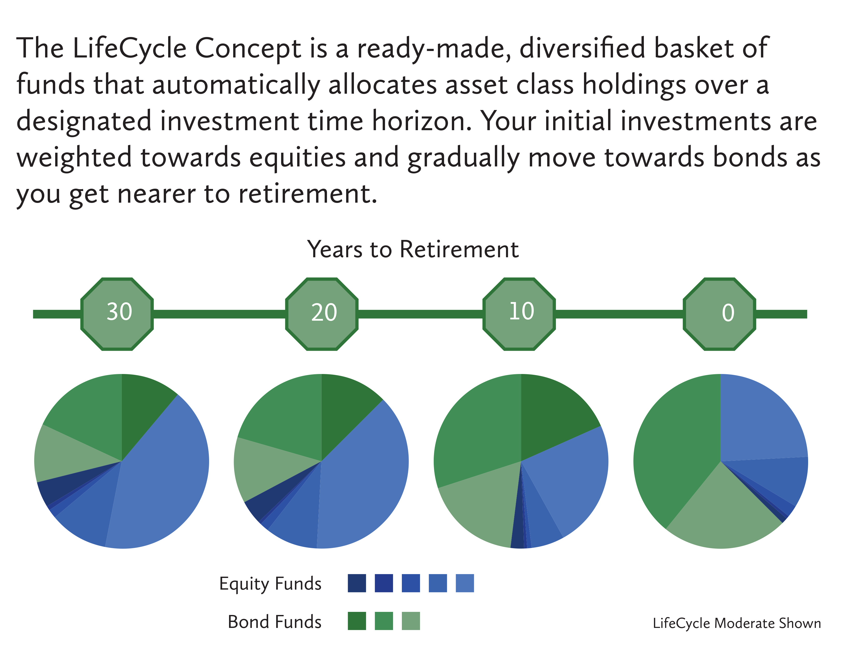
Allianz LifeCycle Concept
Notes:
The longer the time horizon the larger the investment in equities (the blue color).

Slide 58
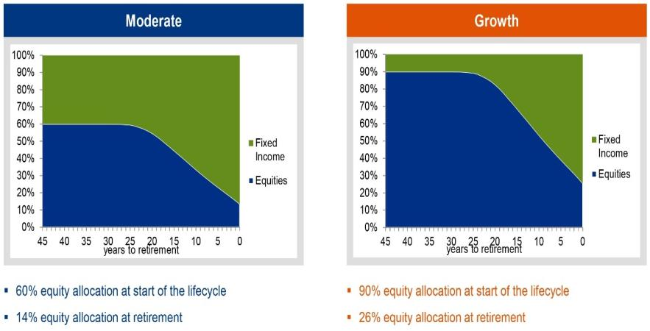
Allianz Lifecycle Concept Two Approaches

Slide 59
Benefits of LifeCycle
Professionally managed
Diversification
Assets invested across asset classes and regions
Automatically moves investments from riskier to safer assets as retirement age approaches
Automatically rebalances investments
At least two times per year

Slide 60
Plan Platform provided by Allianz
International (Offshore)
Retirement Plan

Slide 61
Key Questions
How do I login?
How do I update my contact or beneficiary information?
How do I find my account value?
How do I move/change funds?
How do I request a withdrawal?

Slide 62
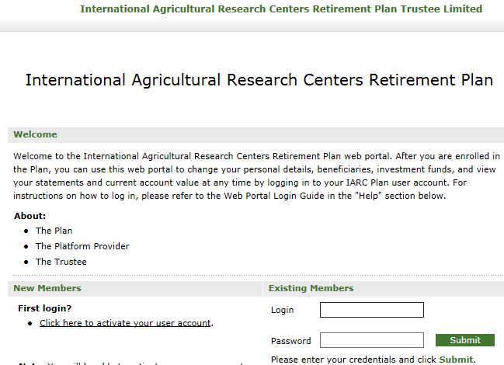
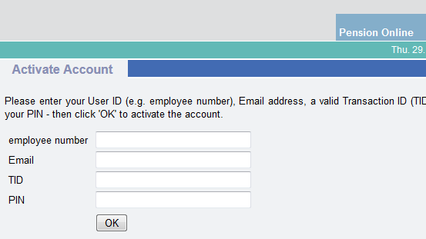
Activate Your Personal Account
Go to the plan platform’s website at www.iarcplan.org via AIARC.org.
Activate your account by entering your login name (six-digit AIARC employee number), email address, PIN and a valid transaction ID (TID).
Valid PIN and TID information is sent to your email by Allianz IARC@allianz.de
Click here to activate your account.

Slide 63
My Data Section
My Account Section
View Quarterly Investment Statements
Update Personal Details
contact information (address, phone, etc.)
beneficiary information
Change Email address or Account Password
View current account balance
View transaction history and pending transactions
Change investment allocations of contributions (existing and future)
Make fund switches or rebalance funds

Slide 64
International Retirement Plan Rules for Withdrawals
Active Employee: | No withdrawals permitted until separated/retired from Center
Separated/Retired:
- Age 55 & Over | Allowed to make withdrawals without penalty
- Under Age 55 | Allowed to make withdrawals but will be assessed a penalty of 33.33% if certain conditions are not met:
 | transfer directly to another retirement plan with similar restrictions become disabled

Slide 65
Questions?

Slide 66
U.S. Retirement Plan

Slide 67
U.S Retirement Plan Topics
Plan Structure
Eligibility / Contributions
Custodial Account / Oversight
Investment Fund Options
Target Date Funds
Plan Platform – Vanguard

Slide 68
U.S. Retirement Plan Resources
AIARC.org Website
Enrollment and Tax Residency Forms
Salary Reduction Agreement Form
Vanguard.com Website (Plan Platform)
Fund Factsheets
Risk Questionnaire
Investment Education & Retirement Calculators

Slide 69
Plan Structure
U.S. Retirement Plan

Slide 70
Key Questions
Who is eligible to participate?
What is a custodial account?
Who oversees the Plan?
How much does my employer contribute?
How much can I voluntarily contribute?

Slide 71
U.S. Retirement Plan Eligibility
To be eligible, you must be (1) employed by a qualifying Center and (2) a U.S. taxpayer.
You are considered a U.S. Taxpayer if you are a U.S. Citizen or lawful Permanent Resident Alien living outside or in the U.S.
Citizens of other countries may be considered a U.S. taxpayer depending on the type of visa held.
Notes:
Resident aliens generally are taxed on their worldwide income, similar to U.S. citizens.
To be classified as a resident alien, the individual must meet one of two tests:
1. Green Card Test
A non-resident alien is a lawful permanent resident of the U.S. at any time if they have been given the privilege, according to the immigration laws, of residing permanently as an immigrant. This status usually exists if the Bureau of Citizenship and Immigration Services has issued a green card.
2. Substantial Presence Test
A non-resident alien is classified as a resident alien for tax purposes if they were physically present in the U.S. for 31 days during the current year and 183 days during a three-year period that includes the current year and the two years immediately before that.
Information on the test is available at http://www.irs.gov/pub/irs-pdf/p519.pdf

Slide 72
U.S. Retirement Plan Structure
The Plan was established in 1996 to help Center employees save for retirement.
The Plan provides for the creation and administration of custodial accounts to receive contributions from the Center on behalf of the Plan participants in accordance with Section 403(b)(7) of the Internal Revenue Service Code.

Slide 73
U.S. Retirement Plan Structure
AIARC is the Plan sponsor with each Center adopting the Plan prototype.
The Plan is overseen by the AIARC Board of Directors.
AIARC serves as Plan administrator and manages the day-to-day activities.
AIARC contracts with Vanguard to administer the U.S. Plan’s platform.

Slide 74
Contribution Schedule
Center (Employer)
15% of salary
Voluntary (Employee)
Up to 100% of your net salary on a monthly basis
Note: The Internal Revenue Service imposes annual limits for both voluntary and total contributions.

Slide 75
2018 Maximum Limits
 | Under Age 50 | Age 50 and Over
Employee Contributions | $18,500 | $24,500
Employee and Employer Contributions | $55,000 | $61,000
Highly Compensated Threshold | $120,000 | $120,000
Annual Compensation Basis | $275,000 | $275,000
Notes:
the maximum amount of annual compensation that can be taken into account when determining employer and employee contributions is $270,000.

Slide 76
Contribution Tip
Update your Salary Reduction Agreement (SRA) Form each January to maximize your voluntary contribution.
If you are interested in making voluntary contributions, please contact your Center’s AIARC Coordinator to assist you in calculating your maximum allowable amount.

Slide 77
Investment Fund Options
U.S. Retirement Plan

Slide 78
U.S. Retirement Plan Investment Fund Options
16 fund choices + target date funds (fund of funds)
Actively managed funds and passive (index) funds
Diverse mix of asset classes
Globally diverse funds

Slide 79
U.S. Retirement Plan Investment Fund Choices
Money Market | Bonds
New York Life GI Account | Templeton Global Bond Fund
 | Vanguard High-Yield Corporate Fund
 | Vanguard Inflation-Protected Securities
 | Vanguard Total Bond Market Index Fund

Slide 80
Investment Fund Choices
U.S. Stock | International Stock
Neuberger Berman Socially Responsive | Oppenheimer Developing Markets
Vanguard 500 Index Fund | Vanguard Total International Stock Index
Vanguard Explorer Fund | Specialty Stock
Vanguard Extended Market Index Fund | Vanguard REIT Index Fund
Vanguard Morgan Growth Fund | Balanced Funds
Vanguard Selected Value Fund | Vanguard Wellington Fund
Vanguard Windsor II Fund

Slide 81
Investment Fund Choices
Current Dates | Future Dates
Vanguard Target Retirement Income | Vanguard Target Retirement 2025 Fund
Vanguard Target Retirement 2015 Fund | Vanguard Target Retirement 2030 Fund
Vanguard Target Retirement 2020 Fund | Vanguard Target Retirement 2035 Fund
 | Vanguard Target Retirement 2040 Fund
 | Vanguard Target Retirement 2045 Fund
 | Vanguard Target Retirement 2050 Fund
 | Vanguard Target Retirement 2055 Fund
 | Vanguard Target Retirement 2060 Fund
 | Vanguard Target Retirement 2065 Fund
The years refer to the anticipated time of retirement. A person who expects to retire in 47 years would choose “…2065”, because 2018 + 47 years = 2065.

Slide 82
Target Date Allocations
Years till retirement…

Slide 83
Plan Platform provided by Vanguard
U.S. Retirement Plan

Slide 84
Key Questions
How do I login?
How do I update my contact and beneficiary information?
How do I find my account value?
How do I move/change funds?
What are the rules for withdrawing funds?

Slide 85
Activate Your Personal Account
Go to the plan platform’s website at www.vanguard.com
Choose “Vanguard’s Website for Retirement Plan Participants”.
Click “Register” near the upper-right corner of the page.
Follow the prompts to enter your personal information. The Plan number is “093962”.
If you used AIARC’s address of record, enter “22314” when it asks for your ZIP code.
Instructions for accessing your account can be found at the www.AIARC.org website.

Slide 86
Plan Details
Research Funds
View current investment account balance
View employer and employee contributions
View account performance
View transaction history and quarterly statements
View all investment options
Change investments
Change investment allocations
View Fund Fact Sheets
View Fees & Expenses

Slide 87
Education & News
My Profile
Plan News
Investment Basics
Retirement Planning
Market & Economy
Estate Planning
Change contact information
Change password and security questions
Change beneficiary information

Slide 88
U.S. Retirement Plan Rules for Withdrawals
Active Employee: | No withdrawals permitted until separated/retired from Center
Separated/Retired:
- Age 59½ & Over | Allowed to make withdrawals without penalty
- Under Age 59½ | Allowed to make withdrawals but will be assessed a penalty of 10% and subject to ordinary income tax if certain conditions are not met:
 | transfer directly to another retirement plan with similar restrictions become disabled

Slide 89
Questions?
Thank You!

