Slide 1
IARC Insurance Plans
World Vegetable Center
14 June 2018

Slide 2
Insurance Topics
Partners (Vendors)
Eligibility
Dependents
Separated and Retired
Health
Medical
Prescription Drugs
Vision
Dental

Slide 3
Insurance Topics (continued)
Assistance Services & Evacuation
Emergency Medical
Security
Death & Disability
Life
Accidental Death and Dismemberment
Long Term Disability
Business Travel Accident
How Your Insurance Works
Sample Scenarios

Slide 4
Disclaimer
This presentation is only intended to provide general information about the insurance plans administered by AIARC and does not cover every exception or possibility.
The information presented does not in any way override the plan rules and the policy documents between AIARC and the plan providers, which constitute the legal documents that govern the operation of the insurance plans.
The plan rules and policy documents will prevail in the event of any conflict, as the plan rules and policy documents are controlling.

Slide 5
IARC Insurance Plan
Partner | Benefit | Eligibility
Cigna Healthcare | Medical Vision Prescription Drugs | Active Employees Bridging Employees Retired Employees
Cigna Healthcare | Dental | Active Employees Bridging Employees
ISOS | Emergency Evacuation (Medical & Security) | Active Employees
Generali | Life Accidental Death & Dismemberment Long Term Disability | Active Employees
Chubb | Business Travel Accident | Active Employees
Notes:
Monthly premium for single participants.
Single Intl: Rate=$104/mo., ded=200, max out=$1,000
Single US: Rate=$263/mo., ded=200, max out=$2,500
Single I Retiree – $243
Single US 65 non Medicare $652
plan pays 90% in network co-insurance

Slide 6
Eligibility – Active Employees
A full-time employee working your Center’s normal work week.
A part-time employee working at least 20 hours a week or 50% of your Center’s normal work week and expected to work at the Center for at least one year.
A long-term consultant contracted to work for a participating Center for at least a year.
A short-term employee or consultant contracted to work for a Center less than a year.
A visiting scientist working temporarily at a Center.
A trainee/student in a Center’s training/educational program. Coverage is limited to two months or less.*
A very short-term employee working for two months or less.*
* Individuals who qualify as trainees/students or very short-term employees are not eligible for the dental and vision benefits.

Slide 7
Eligibility – Dependents
Dependents are also eligible for coverage to include your spouse or domestic partner, and your eligible children. An eligible child must:
be younger than age 26;
be biologically related to or adopted by you or your spouse or domestic partner;
live with you or maintain the same permanent address as you; and,
receive more than half of his or her support from you.
Note: A child attending university away from home is considered to live at the same permanent address as the Center employee or retiree.

Slide 8
Eligibility – Bridging/Retired
Bridging
You must have worked for an AIARC member Center and have participated in the IARC Medical Plan for at least 24 consecutive months immediately prior to your separation/termination.
Bridging coverage is limited to 12 months after your termination.
Retired
You must be at least 55 years old.
You must have worked for an AIARC member Center and have participated in the IARC Medical Plan for at least 120 months including the 60 consecutive months immediately prior to your retirement.

Slide 9
Medical Plan
Cigna Healthcare

Slide 10
Important Definitions Annual Deductible
The deductible amount is that portion of a covered medical expense that the participant must pay before the co-insurance is applied.
For example, if a covered expense of $500 is submitted for payment to the Plan with a $200 deductible, the participant must pay the first $200 of covered expenses prior to the Plan paying for any expenses. The deductible must be met by the participant once each calendar year.
Notes:
Your ticket into the Plan – Entrance Fee

Slide 11
Important Definitions Co-Insurance (Cost Share)
The co-insurance describes the cost sharing arrangement between the participant and the Plan. The Plan’s percentage of payment represents the benefit amount that the Plan pays after the deductible has been met.
For example, after the deductible has been met, the Plan would pay 90% of the charges and the participant (an employee of a Center) would pay 10% of the charges.

Slide 12
Important Definitions Out-of-Pocket (OOP) Limit
The Plan limits how much is paid by the participant in out-of-pocket (OOP) costs after the deductible is met in any calendar year.
After the OOP Limit is reached, the Plan pays 100% of covered expenses for the remainder of that calendar year.

Slide 13
Important Definitions In-Network Provider
Refers to the health care professionals and facilities that the insurance company has contracted with to deliver services at a negotiated rate (discount)
A provider that hasn’t contracted with the insurance company is called an “out-of-network provider.
Insured individuals usually pay less when using an in-network provider because these professionals and facilities provide services at lower cost to the insurance companies with which they have contracts with.

Slide 14
Medical – International Plan
Medical Care | Care Received Outside U.S. | Care Received in U.S.
International Plan (paying non-U.S. premium rates) | Any Provider | CIGNA OAP In-Network Provider | CIGNA Out-of-Network Provider
Annual Deductible Per Individual Family Maximum | $200 $400 | $300 $600 | $500 $1,000
Hospital Deductible | None | None | $500 per admission
Co-Insurance (Plan Pays) | 90% | 80% | 60%
(Applies to Medical Claims, except Preventive Care)
Annual Out-of-Pocket Limit Per Individual Family Maximum | $1,000 $2,000 | $3,000 $6,000 | $6,000 $12,000
Notes:
Generally based on where an individual receives care. However, if located in U.S., better to join U.S. Plan
Covers medical, dental, vision, and prescription drug expenses for services and supplies that are required to treat illnesses.
After you pay an annual deductible, the medical plan pays a percentage of the remaining health care expenses – the percentage is based on where you incur the expense and if you use a preferred (in-network) Cigna health care provider.

Slide 15
Medical – U.S. Plan
Medical Care | Care Received in U.S. |  | Care Received Outside U.S.
International Plan (paying U.S. premium rates) | CIGNA OAP In-Network Provider | CIGNA Out-of-Network Provider | Any Provider
Annual Deductible Per Individual Family Maximum | $200 $400 | $400 $800 | $200 $400
Hospital Deductible | None | $500 per admission | None
Coinsurance (Plan Pays) | 90% | 70% | 90%
(Applies to Medical Claims, except Preventive Care)
Annual Out-of-Pocket Limit Per Individual Family Maximum | $2,500 $5,000 | $5,000 $10,000 | $1,000 $2,000

Slide 16
Scenario – Out-of-Pocket Costs
A single employee, enrolled in the International Plan, working in Nairobi becomes ill and obtains treatment at a local hospital. Her costs total $2,500.
She later travels to Washington, DC, and becomes ill again and obtains treatment at an in-network U.S. hospital. Her costs total $5,000.

Slide 17
Out-of-Pocket Costs Nairobi
Hospital Costs | $2,500
Less Deductible paid by participant | ($ 200)
Net Cost Before Co-Insurance | $2,300
Participant pays 10% | ($ 230)
Insurance pays 90% (reimbursement) | $2,070
Participant Out-of-Pocket Costs = $200 + $230 | $ 430

Slide 18
Out-of-Pocket Costs Washington
Hospital Costs | $5,000
Less Deductible paid by participant ($300) | ($ 100)*
Net Cost Before Co-Payments | $4,900
Participant pays 20% | ($ 980)
Insurance pays 80% (reimbursement) | $3,920
Participant Out-of-Pocket Costs = $100 + $980 | $1,080
*Note: The $200 deductible paid in Nairobi counts towards satisfaction of the $300 deductible applicable for treatment in the United States.

Slide 19
Medical Preventative Care
Note: Medical preventative care is covered at 100% with no deductible.
Preventative exams | one routine physical exam up to per calendar year per adult and per child age 2 through 18 one women’s gynecological exam, pap smear and related lab work per calendar year well-baby physical exams including immunizations — up to 6 exams in the 1st year and 2 exams in the 2nd year, with no annual maximum limit
Preventative vaccinations | 25 World Health Organizations recommended vaccinations to include: DI-TE-PER vaccinations for diphtheria, tetanus and whooping cough combined vaccinations for measles, mumps and rubella; pneumococcal vaccinations for children and adults age 65+ (subject to pre-approval) HPV, hepatitis A and B, influenza, meningococcal, polio (IPV), rotavirus vaccinations Preventive treatment for malaria Haemophilus influenza type B vaccinations Shingles vaccinations

Slide 20
Vision Benefit
Annual Eye Exam | One vision exam reimbursed at 100% with no deductible, per individual, per calendar year
Vision Materials | Vision materials (i.e. frames, glasses, lenses, etc.) are reimbursed at 80%, up to a maximum of $300 per calendar year.

Slide 21
Scenario – Eye Care Out-of-Pocket Costs
Participant has an annual eye exam and requires new glasses (lens and frames). The eye exam costs $99 and the glasses cost $400.
Hint:
Annual eye exam is considered preventive.
Glasses have a maximum reimbursement amount.

Slide 22
Participant Out-of-Pocket Eye Care Cost
Annual eye exam is covered at 100% with no deductible.
Employee pays $100 because of $300 Cap on glasses.
If Glasses Cost: | $300 | $375 | $400 | $500
Insurance Pays 80%, up to $300 | $240 | $300 (max) | $300 (max) | $300 (max)
Employee Pays | $ 60 | $ 75 | $ 100 | $200
Employee’s Percentage of Total Cost | 20% | 20% | 25% | 40%

Slide 23
Prescription Drugs
For outpatient prescription drugs received outside the U.S. and inpatient drugs received anywhere, claims are reimbursed by Cigna and treated the same as any other Plan expense.
Prescription Drugs Retail — 30 Day Supply | Care Received Outside U.S. | Care Received in U.S.
Drug Category (Tier) | Any Provider | CIGNA In-Network Provider | CIGNA Out-of-Network Provider
 |  | Pays 100% after copay:
Generic (Tier¹) | 90% | No copay | No coverage
Preferred Brand (Tier²) | 90% | $25/Rx copay | No coverage
Non-Preferred Brand (Tier³) | 90% | $80/Rx copay | No coverage
¹ Generic is non-brand equivalents to brand name drugs that can be purchased at discount.
² Brand name drugs that can be purchased at discount.
³ Brand name drugs that are not discounted by drug manufacturer.

Slide 24
Prescription Drugs in the U.S.
When in the U.S., you must always present your Cigna ID card to the pharmacy to receive the Plan’s discounted price. Otherwise you will have to pay full price and will not be able to file for reimbursement.
Your Cigna ID card has the following information that is required by pharmacies to process orders:
RX issuer (80840)
Rx Bin 017010
RX PCN 02160000

Slide 25
Dental Benefit
Note: Only active employees and bridging participants are eligible for the dental benefit.
Dental Care | Care Received Outside U.S. | Care Received in U.S.
Active Employee/Bridging | Any Provider | CIGNA PPO In-Network Provider | CIGNA Out-of-Network Provider
Annual Maximum | $1,000 per individual, per calendar year
Deductible | None
Preventative Care | 100% | 100% | 90%
Basic Restorative Care | 80% | 80% | 70%
Major Restorative Care | 60% | 60% | 50%
Treatment of Temporomandibular Joint Disorder | Not covered
Cosmetic Dentistry | Not covered
Orthodontics | Not covered

Slide 26
Dental Preventative Care
Note: Dental preventative care is covered at 100% (no co-insurance) with no deductible.
Dental Preventative Care | oral exams: 2 per year cleanings: 2 per year fluoride application: 1 per year – children only dental sealants on permanent molars: 1 every 3 years - children only bitewings: 1 set per year full mouth x-rays: 1 set every 3 years

Slide 27
Tips for saving money
Take advantage of the preventative care benefit offerings that are covered at 100% (no co-insurance) with no deductible.
You can minimize your costs for health care by using providers in Cigna’s network of preferred providers. Cigna has negotiated discounted fees with these providers, so while the Plan pays 90% of most medical expenses, your portion of costs will be lower by using Cigna providers.

Slide 28
Cigna Personal Webpage
Employee is able to access the following information by logging in to his/her Cigna Personal Webpage:
print membership cards/insurance certificates;
find Cigna network providers;
submit claims;
request for Guarantee of Payments;
Note: Instructions for accessing the Cigna personal webpage can be found on the AIARC.org website.

Slide 29
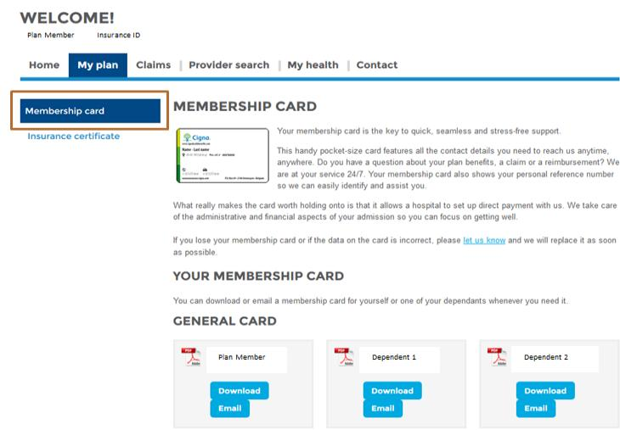
Print Membership Card

Slide 30
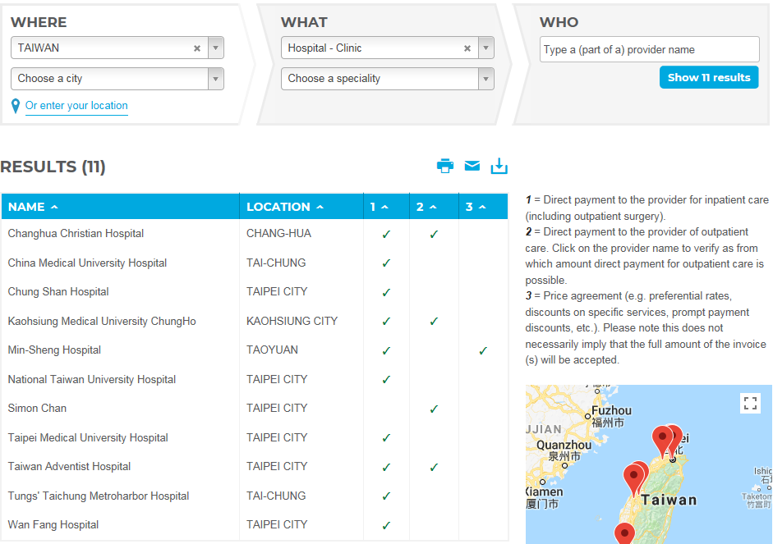
Find Cigna Network Providers

Slide 31
Submitting Claims
Online
Scan all invoices and other supporting documents in advance.
Enter required information in the Online Claiming Application, complete the form and attach the scanned documents.
A confirmation notice will be sent from Cigna via e-mail for a successful submission.
By Post
Download Medical Claim Form from Cigna Web.
Use one line per invoice to describe required information.
Print and sign the form.
Send completed and signed forms, including copies of supporting documents to designated medical claims center.

Slide 32
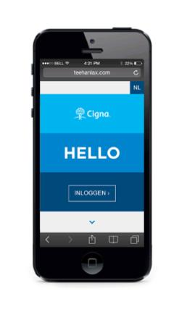
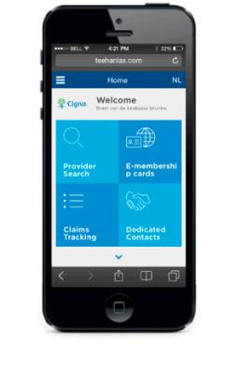
Mobile app
A multilingual mobile version of the dedicated personal webpages
Location-based health care provider search
E-membership card
Claims tracking
Dedicated contacts
Message alerts
My profile
Notes:
Use this slide if member has no access to online & photo claiming

Slide 33
Submit your claims anytime, anywhere
1
Open the Cigna Health Benefits app.
2
Complete the form.
Check out the new feature in this video
3
Take a picture of your invoices.
Notes:
Delete this slide if member has no access to online & photo claiming.

Slide 34
Tips for submitting medical claims
All qualifying claims should be submitted within 90 days after the date of service.
Submit one separate claim per patient.
Make sure that all required information is completed (see next slide).
Keep original documentation for a period of six months after the claim submission.

Slide 35
Required Information for Submitting Medical Claims
Plan Member and Patient Information
Date of Service
Description of each service received
Currency of the Claim
Exact Amount of Expenses
Additional Diagnosis Information
Bank details for payment by transfer

Slide 36
Guarantee of Payment
To avoid paying the total cost of your medical treatment in advance and to reduce overall costs, it is recommended that you request a Guarantee of Payment from Cigna.
A Guarantee of Payment states whether or not the required treatment is covered and what portion of the expense is covered by Cigna.
Patient pays his/her portion of the required deductible and co-insurance to the healthcare provider.
Cigna pays its portion of the costs directly to the healthcare provider.

Slide 37
How to request a Guarantee of Payment
For planned treatments, have your healthcare provider complete the Cost Estimate Form from the Cigna website that requests the following information:
diagnosis;
treatment;
name and contact details of the health care provider;
date of admission and discharge.
Send the completed Cost Estimate Form to Cigna at least three weeks prior to the date of the scheduled treatment at authorization@cigna.com.
Notes:
A Guarantee of payment will be issued when the conditions below are met:
diagnosis and treatment are covered under the terms and conditions of your plan;
the expenses are reasonable and customary.

Slide 38
Tips for requesting a Guarantee of Payment
It is recommended that you use Cigna in-network providers for planned or emergency hospital admissions because a Guarantee of Payment will be easier and faster to obtain than for an out-of-network provider.
For out-of-network providers, you may have to pay the provider in advance and submit the full claim to Cigna for reimbursement.
For faster responses, call Cigna via telephone.

Slide 39
ISOS Assistance Services

Slide 40
ISOS Assistance Services
Emergency Medical | Security | Travel
Evacuation and repatriation | Emergency Evacuation | Pre-trip advice and travel alerts
Transportation assistance for family | Online Information and analysis | Message transmission
Post-evacuation travel | Security advice and assistance | Translation
Repatriation of mortal remains |  | Lost document advice
Inpatient and outpatient assistance |  | Legal referrals

Slide 41
AIARC-ISOS Online Portal
Log into the AIARC ISOS account by clicking on the AIARC-ISOS web portal from the AIARC website at https://www.aiarc.org/ISOS-Services.
Alternatively, you can access the same account using the AIARC membership number 11BCMA612778 at https://www.internationalsos.com/.

Slide 42
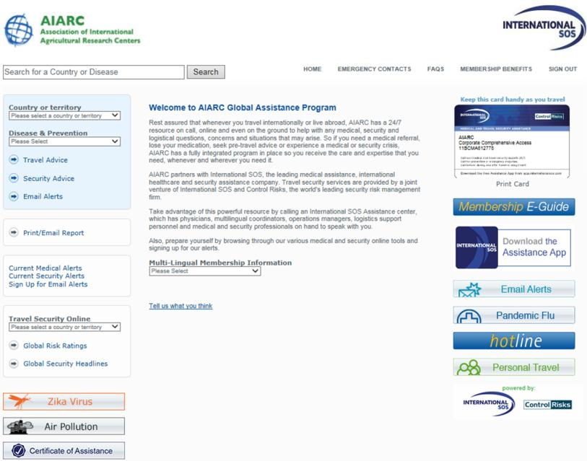
AIARC Specific Online Portal
Subscribe to
Alerts
Use the Membership
E-Guide to
educate yourself
Sign up for
Email alerts
Research for synopsis of
upcoming security related
events for your destination

Slide 43
Tips for being prepared
Read the ISOS E-Guide to learn how to:
seek ISOS assistance
find the latest medical and security information about a destination
use the International SOS Assistance App.
Print an electronic membership card.
The AIARC Membership Number is 11BCMA612778.

Slide 44
Tips for being prepared
Always carry a copy of your ISOS membership card with you and download the free ISOS Assistance App on your smartphone to quick dial the nearest ISOS assistance center from your phone.
The mobile app provides you with:
One-touch call to the nearest ISOS Assistance Center
Current medical and security alerts

Slide 45
Tips for being prepared
Check the Online Country Guide for recommended pre-trip vaccinations, common diseases, embassy locations, visa information, and in-country safety tips.
Sign up for Email alerts to receive updates on health and security risks directly to your email address.

Slide 46
When an Emergency happens
Call the 24 hour assistance center at +1-215-942-8226 by placing a collect call or call any of the nearest ISOS Assistance Centers listed on your ISOS Membership Card or the smartphone App.
When you call you will be asked to provide your name, Center’s name, the name of the injured party, location, and a description of the situation.

Slide 47
Emergency Medical Evacuation
If you sustain an injury or suffer a sudden and unexpected illness and adequate medical treatment is not available in your current location, ISOS will arrange and pay for a medically supervised evacuation to the nearest medical facility, as determined by an ISOS healthcare physician and the attending medical personnel, to be capable of providing appropriate medical treatment.

Slide 48
Death & Disability
Generali International
Chubb

Slide 49
Death & Disability
Benefit | Event | Payout Amount | Eligibility
Life | Death | 3 or 5 × Salary Fixed $50K or $100K | Full- or Part time- Employee Long-term Consultant Short-term Employee Spouses and children of Full- or Part- time Employee are eligible for Accidental Death at 50% and 5%
Accidental Death | Death | 3 or 5 × Salary Fixed $50K or $100K
Accidental Dismemberment | Accident | According to payout schedule
Long Term Disability | Disabled | 70% of Salary after 180 day waiting period | Full- or Part- time Employee
Business Travel Accident | Death | 3× Salary* Fixed $50K or $100K* *with limitations | Full- or- Part- time Employee Long-term Consultant Short-term Employee
Notes:
Accidental Death – 50% for spouse and 5% for children, Dismemberment does not apply to spouse and children
LTD unable to perform your job, after 2 years unable to perform any job.

Slide 50
Accidental Dismemberment Payout Schedule
Result of Injury | % of Normal AD&D Benefit Payable
Loss of both legs or both arms | 100%
Loss of both hands or both feet | 100%
Loss of one arm and one leg | 100%
Loss of sight in both eyes | 100%
Loss of one hand and one foot or leg | 100%
Loss of one arm & one foot or leg | 100%
Removal of lower jaw | 100%
Permanent loss of speech or hearing (traumatic origin) | 100%
Permanent loss of hearing in one ear | 30%
Loss of sight in one eye | 40%
Shortening of lower limb by at least 5 cm | 30%
Shortening of lower limb by 3 to 5 cm | 20%
Shortening of lower limb by 1 to 3 cm | 10%
Anchylosis of the hip | 40%
Anchylosis of the knee | 20%
Notes:
Lose one eye = 40%

Slide 51
Beneficiaries
Beneficiaries are those individuals who will receive the financial benefit from your insurance coverage in the event of your death.
The financial benefit amount will only be paid to those individuals named in the Beneficiary Designation Form for the IARC Insurance Plan.

Slide 52
Tip to make sure that your money goes to those intended
Keep your Beneficiaries up-to-date!
You are responsible for ensuring that your designated beneficiaries (and the beneficiary contact information) are current and accurate, especially in case of a change in your family status (marriage, birth, divorce, etc.).
If you also participate in the IARC Retirement Plan, keep those beneficiaries up-to-date.

Slide 53
Business Travel Accident
Chubb

Slide 54
Business Travel Accident (BTA) Definition
Coverage is only while an employee is on a preapproved overnight business trip away from his or her place of permanent assignment.
Coverage begins at the start of the trip, whether it be from an insured’s place of employment, his or her home or other location and terminates upon the insured’s return to his or her home or place of employment.

Slide 55
BTA - Amount & Limits
Provides life coverage in the amount of 3 times salary up to a maximum payout of $750,000 per employee or a maximum of $50,000 or $100,000 for short-term employees and consultants.
However, in the case of multiple deaths in one incident, the maximum payout is limited to $5 million in total for the entire incident.
If the sum of all the life benefits in that incident exceeds the maximum payout limit of $5 million, an insured’s payout shall be a proportional share of the total salaries.
Notes:
The payout amount is equal to an individual’s pro rata share of the total value of all the salaries times the maximum payout of $5.000,000.

Slide 56
How Your Insurance Works
Sample Scenarios

Slide 57
Scenario #1
A Canadian employee, who works out of Indonesia, dies in an airplane accident while attending a pre-approved business conference in Manila, with an overnight stay. Her annual salary is $50,000 and her Center provides a 5-times salary LIFE/AD&D benefit.

Slide 58
Scenario #1 – Payouts
The LIFE plan pays her beneficiary $250,000 (5-times salary).
Because she died in an accident, the AD&D plan pays her beneficiary an additional $250,000.
Because the accident occurred while she was attending a pre-approved business trip, with an overnight stay, the BTA plan pays her beneficiary $150,000 (3-times salary).
The EVAC plan arranges for and pays the costs to have her remains flown from Manila to her home in Canada.

Slide 59
Scenario #2
As the result of an accident while working in Benin, a U.S. employee requires immediate emergency medical care. The closest adequate care is in South Africa. He recovers but the accident results in the loss of sight in one eye and prevents his return to work for 10 months. His annual salary is $30,000 ($2,500/month) and his Center provides a 5-times salary LIFE/AD&D benefit.

Slide 60
Scenario #2 – Payouts
Once ISOS is contacted and agrees to the emergency evacuation, the EVAC plan arranges and pays for his evacuation to South Africa and his return to the U.S. (home country) for rehabilitation.
The MED plan pays its share of cost for all necessary medical care he receives. Cigna works with ISOS to arrange hospital admission, and guarantee of payment and to manage his treatment in South Africa.
For loss of sight in one eye, the AD&D plan, per the policy schedule, pays him a benefit equal to 40% of his normal AD&D benefit, which in this case is $60,000 (40% of $150,000 coverage).
After 6 months of disability and upon approval by Generali, the LTD plan pays him a monthly benefit of $1,750 (70% of his monthly salary) for the 4-month period immediately prior to his return to work.
Notes:
EME will not pay for return to Benin. Policy ends upon point of origin or country of rehabilitation.
Why only LTD for 4 months? Six month waiting period.
$30,000/12*70% = $1,750 * 4 months = $7,000
If had pension benefit would be an additional 15% of base salary, the normal contribution equaling $30,000/12*15%=$375/mo

Slide 61
Scenario #3
A French employee working in Liberia has a stroke and is evacuated to the U.S. for treatment. He dies 3 months later. His annual salary is $40,000 ($3,333/month) and his Center provides a 5-times salary LIFE/AD&D benefit.

Slide 62
Scenario #3 – Payouts
Once ISOS is contacted and agrees to the emergency evacuation, the EVAC plan arranges and pays for his evacuation to the U.S. and later for the cost to have his remains flown from the U.S. to his home in France.
The MED plan pays its share of costs for all necessary medical care the employee receives in Liberia and the U.S.
The LIFE plan pays his beneficiary $200,000 (5-times salary).
Notes:
Why didn’t the employee get paid for accidental or LTD? Less than six months for LTD.
Why not ADD, a stroke is not an accident.

Slide 63
Scenario #4
An Indian employee and her husband die in a car accident while on holiday in Australia. Her annual salary is $50,000 and her Center provides a 5-times salary LIFE/AD&D benefit.
Hint: Dependents are eligible for the accidental death benefit- spouse at 50% of the employee’s coverage and children at 5%.

Slide 64
Scenario #4 – Payouts
The LIFE plan pays her beneficiary $250,000 (5-times salary).
Because she and her husband both died in an accident, the AD&D plan pays her beneficiary an additional $250,000 and pays his beneficiary $125,000 (50% of $250,000).
The EVAC plan arranges for and pays the costs to have her and his remains flown from Australia to their home in India.
Notes:
Why not BTA? The trip was not an approved business trip. They were on holiday.

Slide 65
Scenario #5
While at his home in Germany, a 50 year old German employee is involved in an accident that paralyzes him from the waist down. He will not be able to go back to work. His annual salary is $60,000 ($5,000/month) and his Center provides a 5-times salary LIFE/AD&D benefit. He is an active participant in the IARC Retirement Plan and his Center’s contribution is 15%.
Note: Participation in the IARC Retirement Plan provides an additional LTD benefit.

Slide 66
Scenario #5 – Payouts
Due to the severity of his paralysis, the AD&D plan pays him 100% of his normal AD&D benefit, which in this case is $300,000 (5-times salary).
After 6 months of disability, the LTD plan begins paying him $3,500/month (70% of $5,000).
In addition, he will continue to receive his normal monthly retirement contribution of $750 ($60,000 × 15% ÷ 12) because he is an active participant in the IARC Retirement Plan.

Slide 67
Questions?
Thank You!

