Slide 1
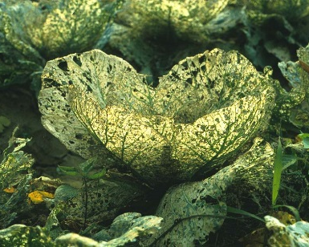
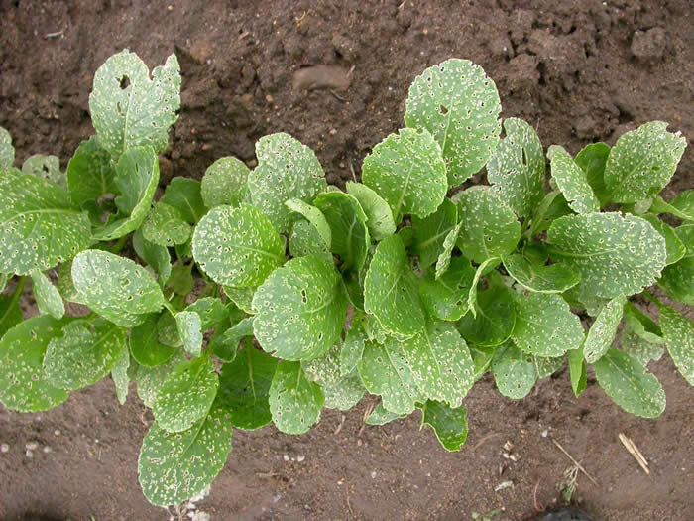
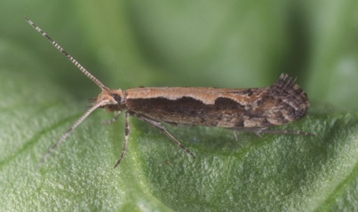
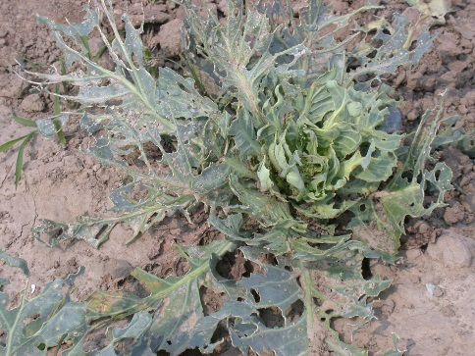
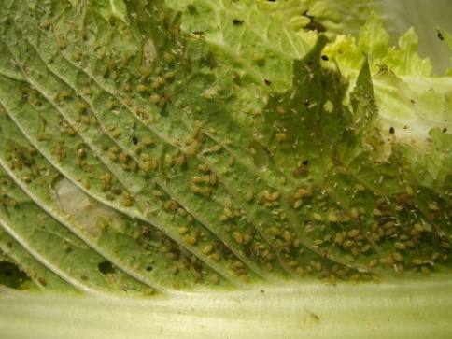
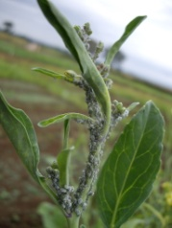
Pest and diseases in leafy mustard
1. Diamondback moth | Leafy Mustard
2. Flea beetle | Leafy Mustard
3. Cabbage butterfly | Leafy Mustard
4. Aphids | Leafy Mustard
Notes:
1 Bean butterfly
2 Dragon fly
3 Diamond backmoth
4 Lady bug
5. Pod borer

Slide 2
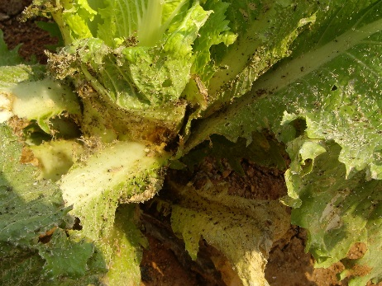
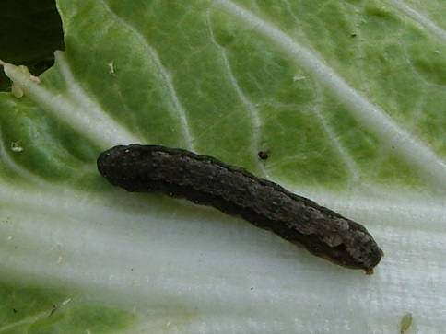
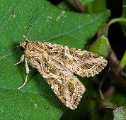
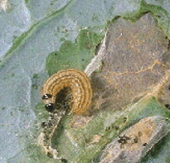
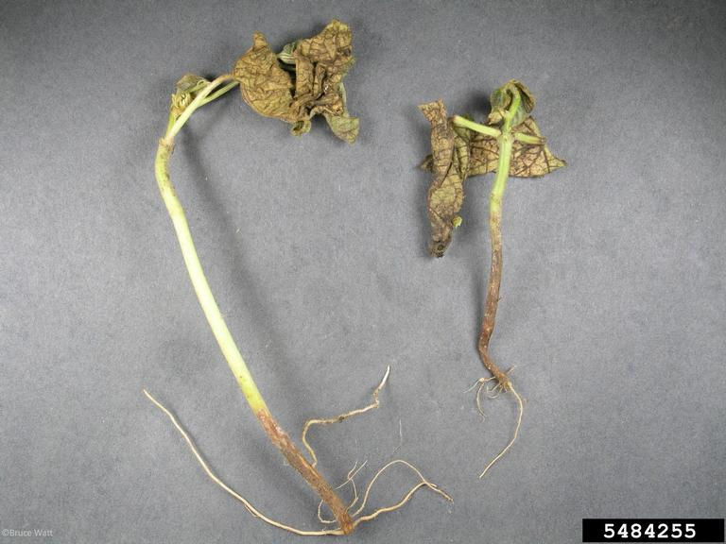
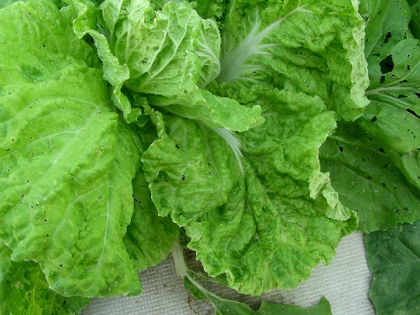
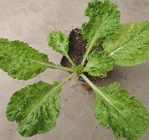
Pest and diseases in leafy mustard
5. Cabbage webworm | Leafy Mustard
6. Common armyworm | Leafy Mustard
7. Damping off (seedlings) | Leafy Mustard
8. Turnip mosaic virus | Leafy Mustard
Notes:
1 Bean butterfly
2 Dragon fly
3 Diamond backmoth
4 Lady bug
5. Pod borer

Slide 3
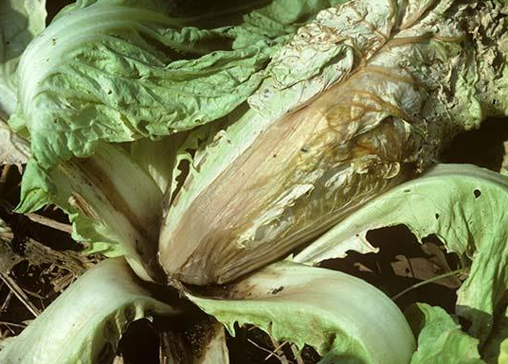
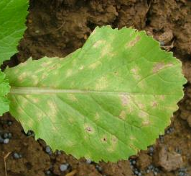
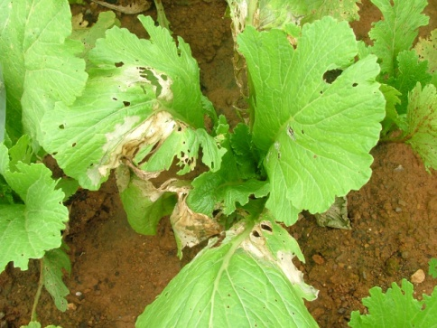
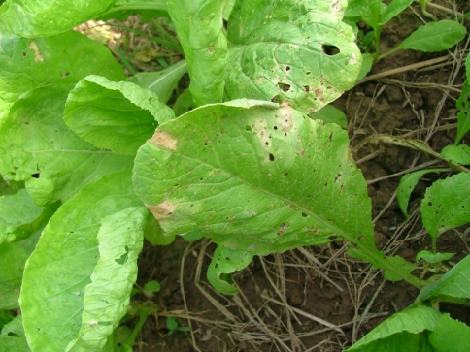
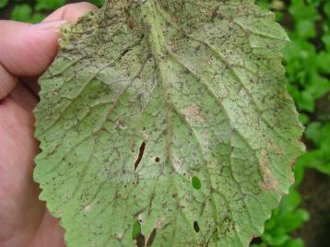
Pest and diseases in leafy mustard
9. Downey mildew | Leafy Mustard
10. Bacterial soft rot | Leafy Mustard
11. Web blight | Leafy Mustard
12. Black rot | Leafy Mustard
Notes:
1 Bean butterfly
2 Dragon fly
3 Diamond backmoth
4 Lady bug
5. Pod borer

Slide 4
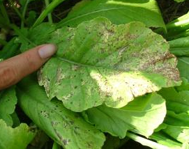
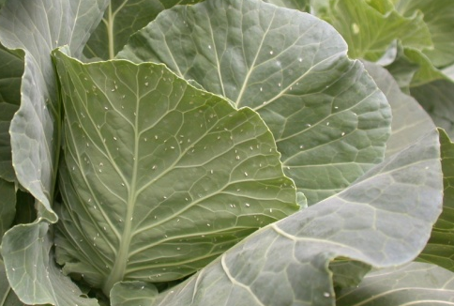
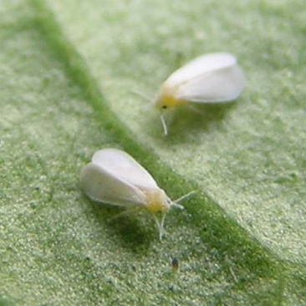
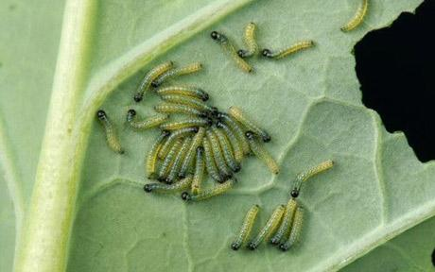
Pest and diseases in leafy mustard
13. Black spot | Leafy Mustard
14. Whitefly | Leafy Mustard
15. Cabbage head caterpillar | Leafy Mustard
Notes:
1 Bean butterfly
2 Dragon fly
3 Diamond backmoth
4 Lady bug
5. Pod borer

Slide 5
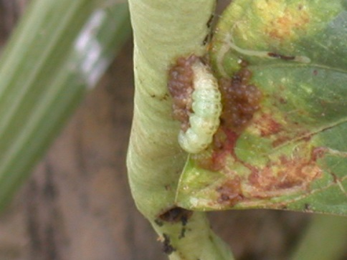
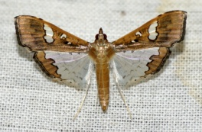
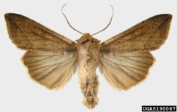
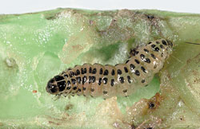
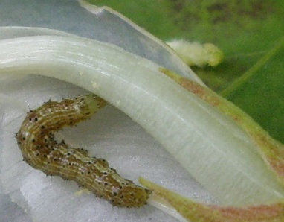
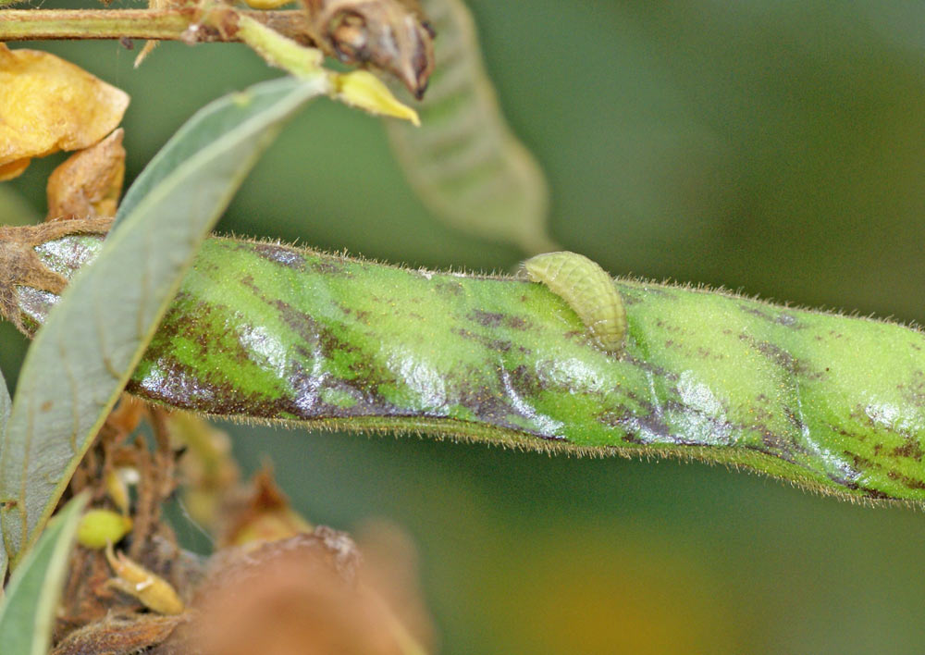
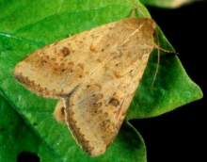
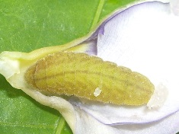
Pest and diseases in yardlong bean
1. Pod borer | Yardlong bean
2. Armyworm | Yardlong bean
3. Bean butterfly | Yardlong bean
4. American bollworm | Yardlong bean
Notes:
1 Bean butterfly
2 Dragon fly
3 Diamond backmoth
4 Lady bug
5. Pod borer

Slide 6
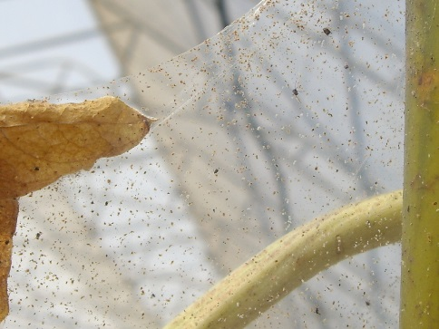
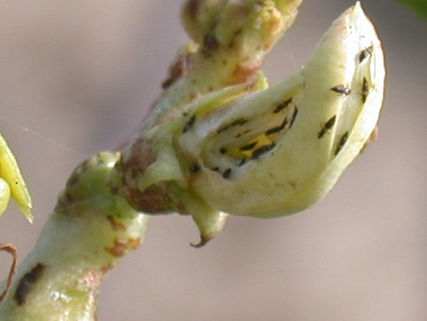
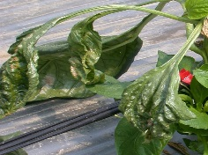
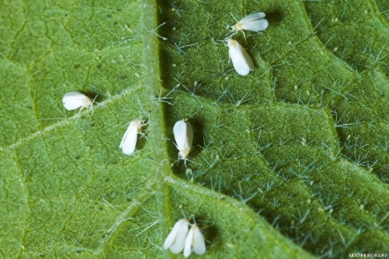
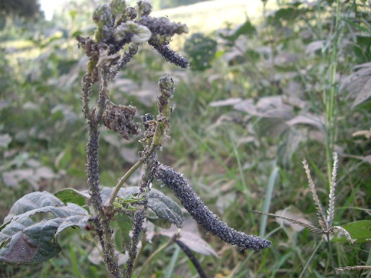
Pest and diseases in yardlong bean
5. Bean spider mite | Yardlong bean
6. Thrips | Yardlong bean
7. White fly | Yardlong bean
8. Aphids | Yardlong bean
Notes:
1 Bean butterfly
2 Dragon fly
3 Diamond backmoth
4 Lady bug
5. Pod borer

Slide 7
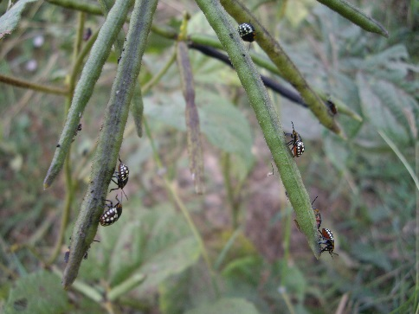
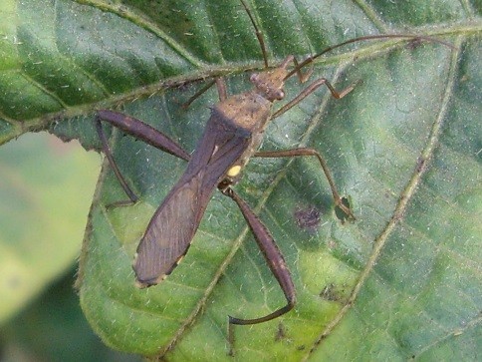
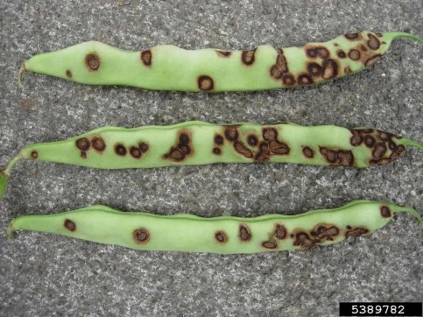
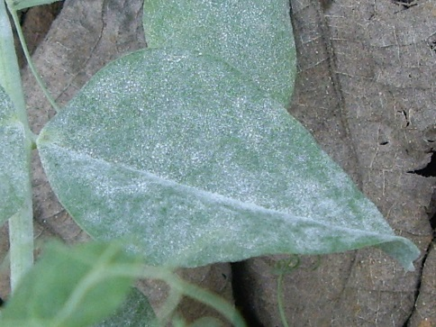
Pest and diseases in yardlong bean
9. Stink bug | Yardlong bean
10. Pod bug | Yardlong bean
11. Bean anthracnose | Yardlong bean
12. Powdery mildew | Yardlong bean
Notes:
1 Bean butterfly
2 Dragon fly
3 Diamond backmoth
4 Lady bug
5. Pod borer

Slide 8
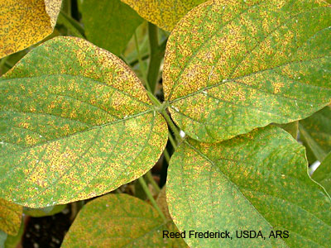
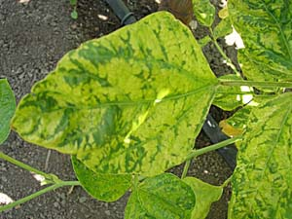
Pest and diseases in yardlong bean
13. Leaf rust | Yardlong bean
14. Bean mosaic virus | Yardlong bean
15. Damping off (seedlings) | Yardlong bean
Notes:
1 Bean butterfly
2 Dragon fly
3 Diamond backmoth
4 Lady bug
5. Pod borer

