Slide 1
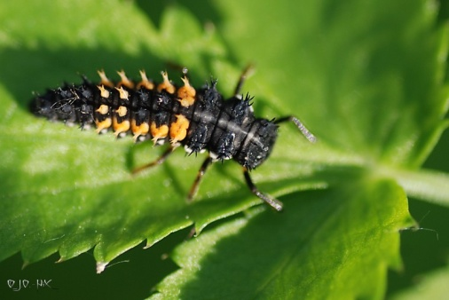
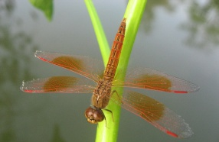
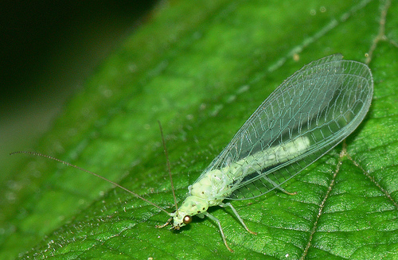
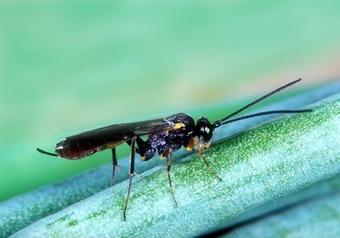
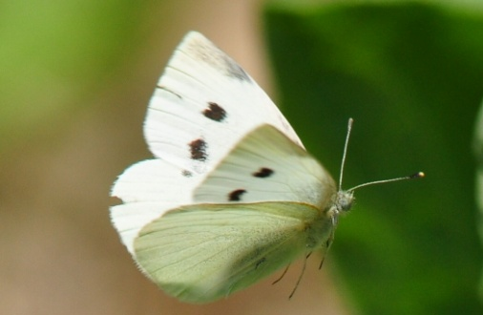
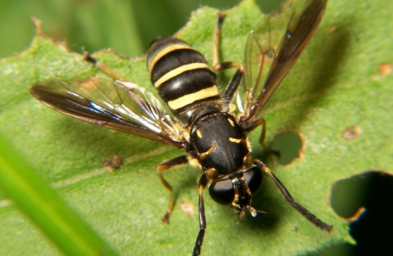
C1. Leafy mustard (1)
1
2
3
4
5
6
7
8
Notes:
1 Striped fleabeetle (harmful)
2 Lady bug nymph (beneficial)
3 Dragon fly (beneficial)
4 Lacewing (beneficial)
5 Diadegma wasp (beneficial)
6 Cabbage looper (harmful)
7 Cabbage butterfly (harmful)
8 Syrphid fly (beneficial)
9 Earthworm (beneficial)
10 Pod borer (harmful)
11 Spider (beneficial)
12 Diamond backmoth (harmful)

Slide 2
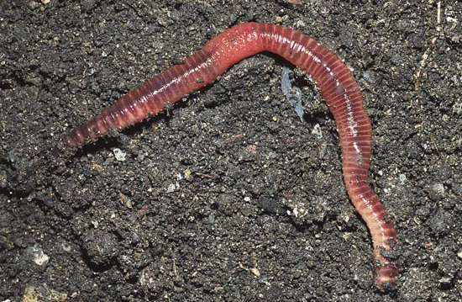
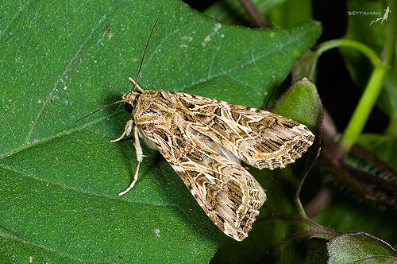
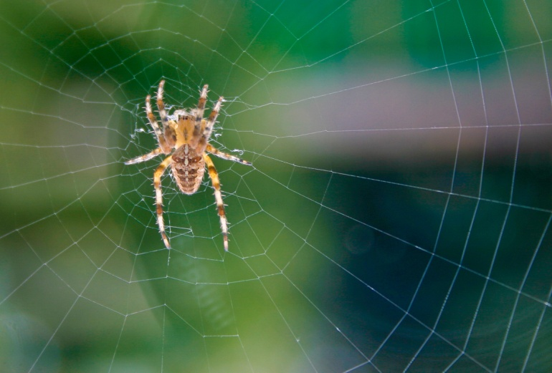
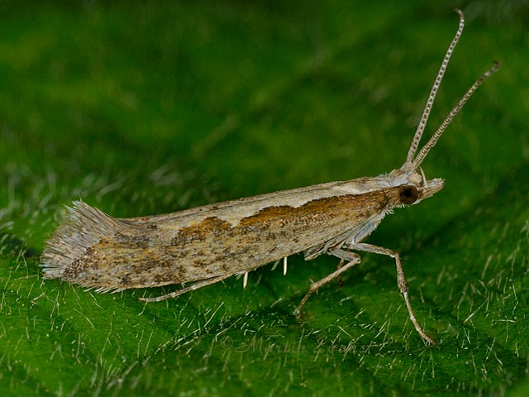
C1. Leafy mustard (2)
9
10
11
12
Notes:
1 Striped fleabeetle (phyllotreta undulata)
2 Lady bug nymph
3 Wasp
4 Dragon fly
5 Lacewing
6 Stink bug (Nezara viridula)
7 Spider
8 Bean fly
9 Diamond backmoth (putella xylostella)
10 Earthworm
11 Pod borer (Maruca vitrata)
12 Bee

Slide 3
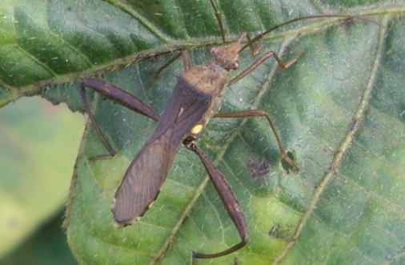
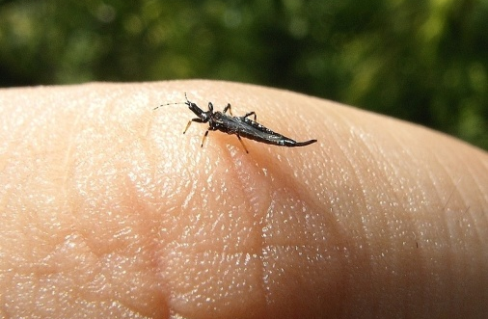
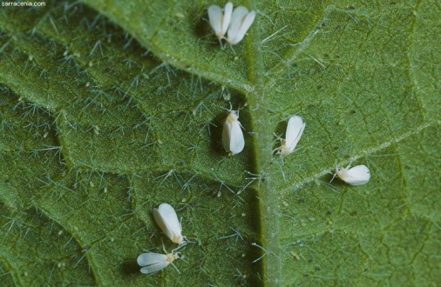
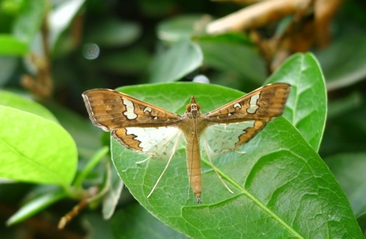
C1. Yard long bean (1)
1
2
3
4
5
6
7
8
Notes:
1 Armyworm (harmful)
2 Lady bug nymph (beneficial)
3 Dragon fly (beneficial)
4 Lacewing (beneficial)
5 Pod bug (harmful)
6 Thrips (harmful)
7 White fly (harmful)
8 Pod borer (harmful)
9 Plant hopper (harmful)
10 Bean butterfly (harmful)
11 Spider (beneficial)
12 Honey bee (beneficial)

Slide 4
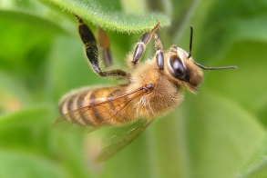
C1. Yard long bean (2)
9
10
11
12
Notes:
1 Armyworm (Spodoptera litura)
2 Lady bug nymph
3 Plant hopper
4 Dragon fly
5 Lacewing
6 Bean butterfly
7 Pod bug (Riptortus spp.)
8 Thrips
9 Spider
10 White fly
11 Pod borer (Maruca vitrata)
12 Bee

Slide 5
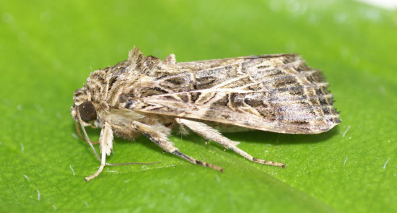
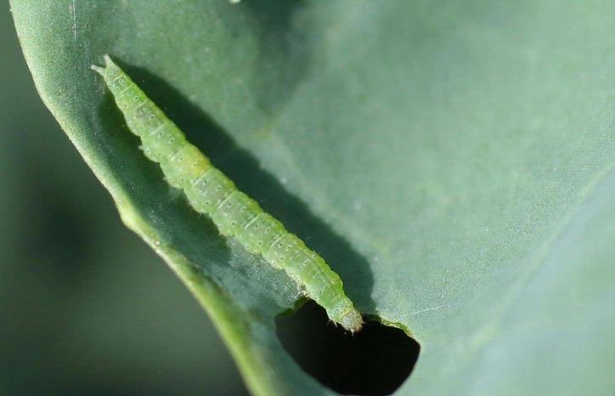
C2. Leafy mustard
A
1
B
2
C
3
D
4
E
5
Notes:
1 Army worm – Spodoptera Litura
2 Dragon fly
3 Diamond backmoth
4 Lady bug
5. Striped bean beetle

Slide 6
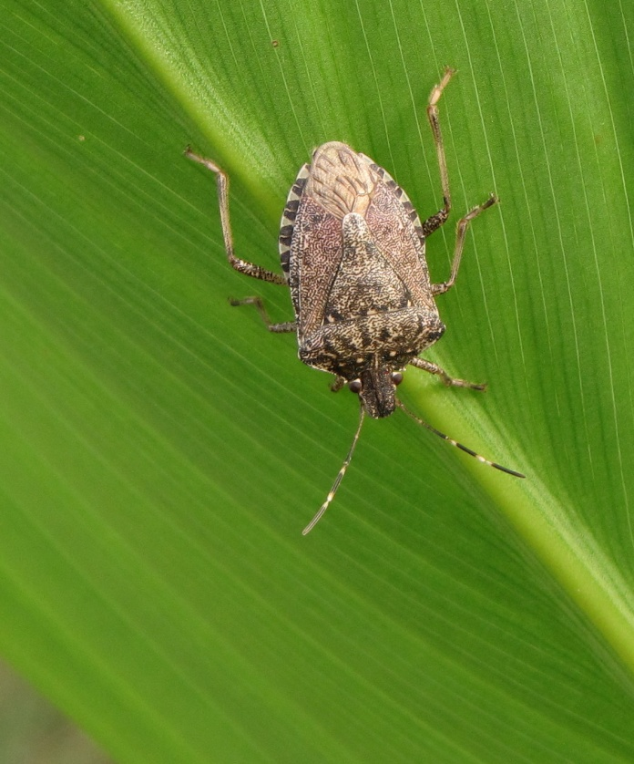
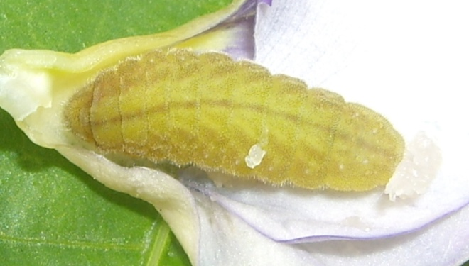
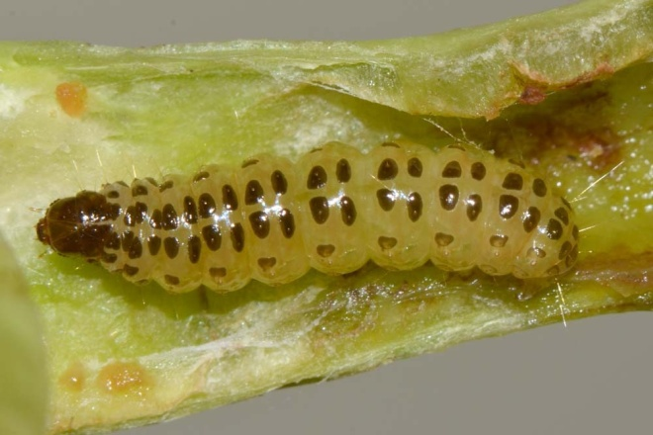
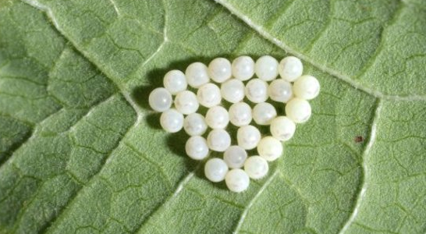
C2. Yard long bean
A
1
B
2
C
3
D
4
E
5
Notes:
1 Bean butterfly
2 Dragon fly
3 Diamond backmoth
4 Lady bug
5. Pod borer

Slide 7
C3. Pesticide safety pictograms
1.
2.
3.
4.
5.
6.
Notes:
1 Bean butterfly
2 Dragon fly
3 Diamond backmoth
4 Lady bug
5. Pod borer

